Slide 1
Insurance Analytics
Project (P946)
By - Group 1

Slide 2




Our Team
Mentor - Mahendra Singh
Anjali Kokkula
Sandhya G L
Farhin Khatoon
Chaitrali Dilip Devale
Aditya Kamalakar Chaudhari
Suhel S. Khan
Pratik Meshram
Group - 1

Slide 3
Agenda
Summary
Problem Statement
Overview of project
KPI Metrics
Excel Dashboard
Power BI Dashboard
Tableau Dashboard
Key Takeaways
Next Steps & Actions
Conclusion

Slide 4
Summary
The Insurance Analytics Dashboard Project provides a consolidated view of performance across key business lines—Renewal, Cross Sell, and New—enabling data-driven decision-making for insurance executives and account managers. The dashboard captures critical KPIs including achievement vs. target, invoice tracking, meeting counts, opportunity stages, and conversion ratios, offering both a high-level overview and individual-level drill-down capabilities.
The analysis integrates data from multiple sources such as Brokerage, Fees, Invoice, Meeting, Opportunity, and Budget files. Using Excel and SQL, the data was cleaned, merged, and structured to support accurate performance measurement across branches and executives. These datasets were then visualized in Power BI through interactive charts and KPIs, including achievement percentages, top revenue opportunities, stage-wise funnels, and executive-wise activity metrics.
This dashboard empowers teams to identify top performers, uncover gaps in sales conversion, and optimize meeting effectiveness and opportunity follow-ups. With clear visibility into underperforming segments and high-revenue pipelines, the solution enhances strategic planning, performance tracking, and accountability across the insurance business landscape.

Slide 5
Problem Statement
Invoice Volume per Account Executive
Year-over-Year Meeting Count
Target vs. Achievement for Income Classes
Opportunity Funnel by Revenue Stage
Meetings by Account Executive
Top Open Opportunities

Slide 6
Objective
The objective of the Insurance Analytics Dashboard Project is to centralize fragmented data sources and provide a comprehensive, real-time performance monitoring system for insurance business operations. It aims to bridge the visibility gap between branch-level targets and achievements across different income classes—Renewal, Cross Sell, and New—by integrating data from brokerage, fees, invoices, meetings, and opportunities.
The dashboard is designed to help management and account executives track progress, measure productivity, and identify performance bottlenecks. By offering a unified view of key metrics such as opportunity pipeline, achievement percentages, executive engagement, and stage-wise revenue, the objective is to enable faster, more informed decision-making, improve sales effectiveness, and support strategic planning through actionable insights.

Slide 7
KPI Metrics
Income Class Achievements
 | Invoice | Achievement
Cross Sell | 15.14% | 26.76%
Renewal | 58.35% | 128.54%
New | 4.21% | 9.20%
Yearly Meeting Count
2019
3 Meetings
2020
31 Meetings

Slide 8
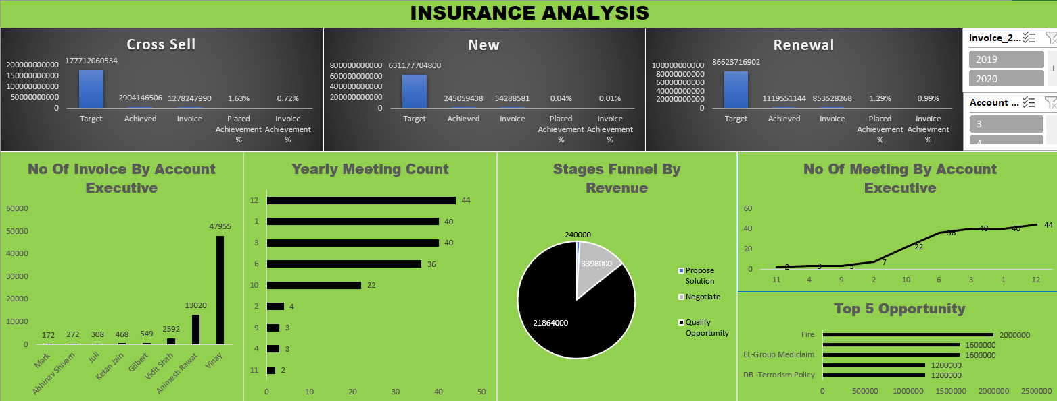
Excel Dashboard

Slide 9
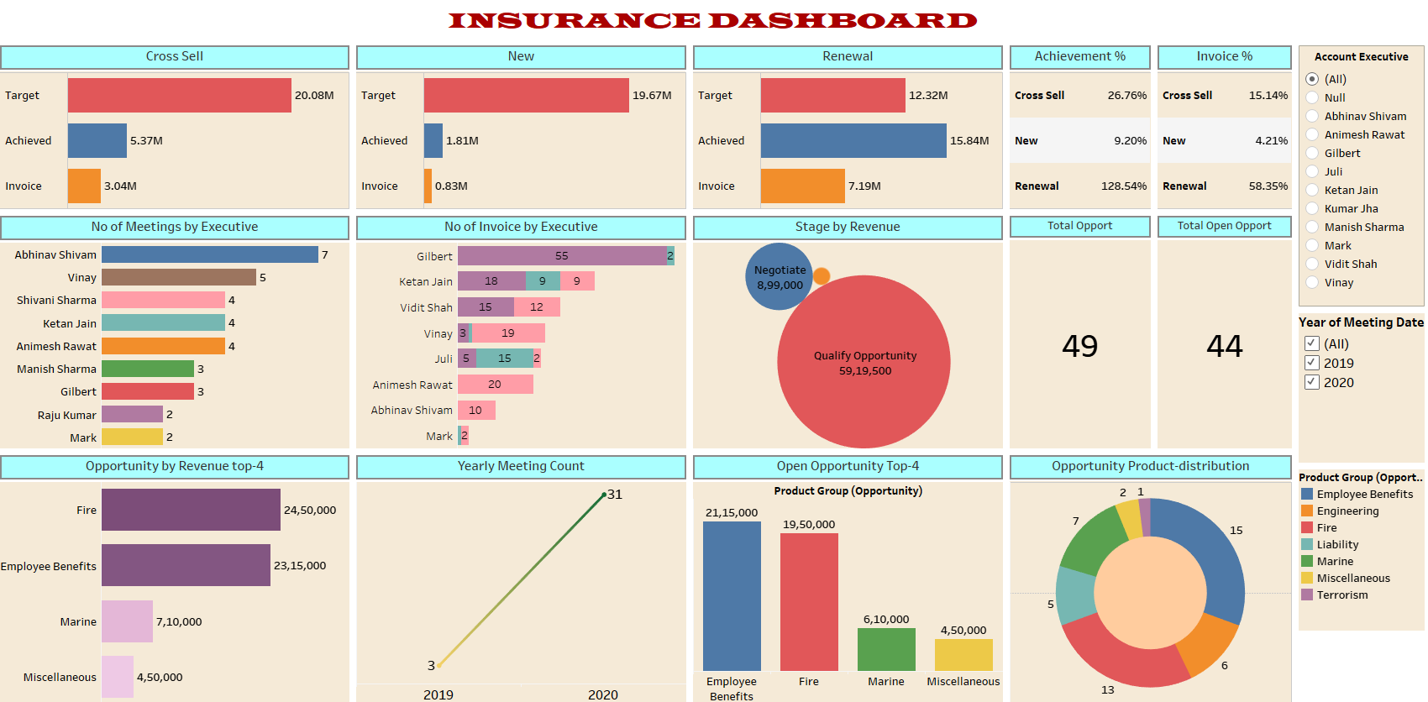
Tableau Dashboard

Slide 10
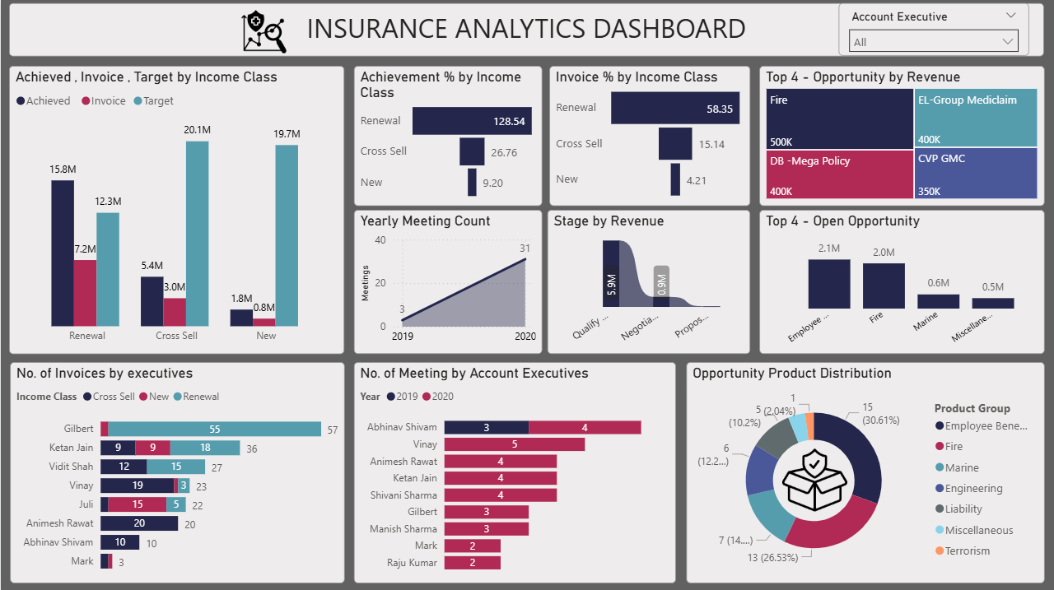
PowerBI Dashboard

Slide 11
Key Findings
Gilbert and Ketan Jain lead in total invoices generated.
Abhinav Shivam and Vinay have the highest meeting activity in 2020.
The revenue funnel shows most revenue is in the Qualify stage (5.9M), dropping sharply in later stages.
Fire, DB - Mega Policy, and EL-Group Mediclaim are top revenue-generating opportunities.
Employee Benefit and Fire dominate open opportunities.
The most frequent product group is Employee Benefit (30.61%), followed by DB-Mega Policy (26.53%)
New and Cross Sell segments are significantly under target.
Renewal is the strongest segment with highest achievement % (128.54%) and invoice % (58.35%).

Slide 12
Next steps and action items
As we move forward, here are the next steps and tasks we need to focus on:
Refining the Dashboards:
We’ll gather feedback from our mentors and make any necessary improvements to the dashboards.
This might include changes in design, adding new visualizations, or refining the data.
Exploring Additional Insights:
We’ll look for more ways to analyze the data.
There might be additional metrics or trends that could be valuable, so we’ll explore these and consider adding them to our dashboards.
Preparing a Detailed Report:
Along with the dashboards, we’ll prepare a detailed report that explains our findings.
This report will help you people to understand the data more deeply.

Slide 13
Conclusion
The Insurance Analytics Dashboard has delivered valuable insights into the performance of Renewal, Cross Sell, and New income streams, highlighting key metrics such as achievement percentages, invoice trends, meeting activity, and opportunity conversion. The analysis has surfaced meaningful patterns in executive performance, revenue funnels, and product-specific opportunities—enabling leadership to identify high-impact areas and align strategic actions accordingly.
Moving forward, the focus will be on enhancing the dashboard with additional KPIs, incorporating real-time data refresh capabilities, and enabling deeper segmentation by branch, executive, and opportunity type. These improvements will support more proactive decision-making, streamline performance reviews, and drive data-led strategies to boost productivity and revenue growth across the insurance business.

Slide 14
Thankyou
Project (P946)
By - Group 1

